Slide 1

Access Sheridan
Revised Version
Luka.N Brent.S Qingqing.W Daniel.M

Slide 2
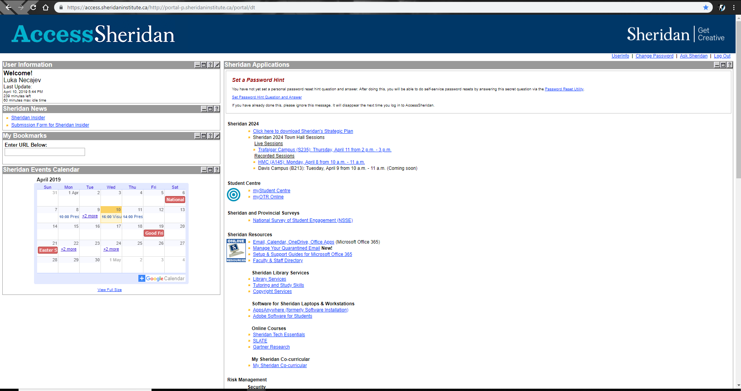
Stating the Concept
What is It ?
Remodeling Access Sheridan
Fixing the Navigational Layout
Giving importance to specific web pages
Fixing Problems within the website
Implementing new features
Original Access Sheridan

Slide 3

Stating the Concept
What is the Target Audience ?
Target Audience
College Teachers
College Students
College Administration
College Tech Department

Slide 4
Survey Findings
Ranking the Features
Features Considered and not implemented

Slide 5
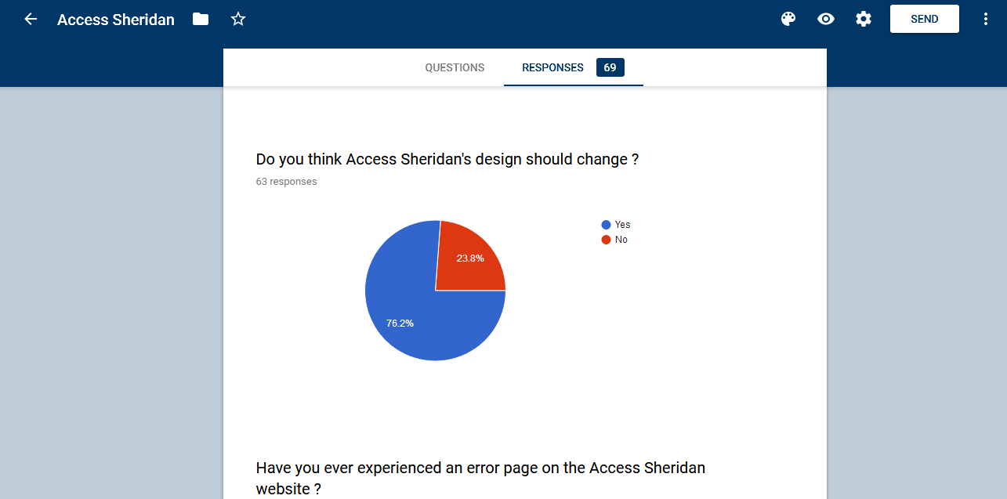
Findings From Survey
Ranked Features
Highest to Lowest Importance
Fixing Outdated Design
Fixing the Navigational System
Making information easy to access
Adding A better designed Calendar feature
Having an easy way to access Free Softwares given by the college
Making Swapping Classes Easier
Adding features that sends notifications
Adding a Search Bar
Adding Notification if Not Achieving co-op
Notes:
Just go over the first 5 the rest are not important,

Slide 6
Findings From Survey
Features Not Considered/Implemented
Features Not Considered but were showed in the Survey
Changing the Theme so it fits in with the current Sheridan Website
Making Access Sheridan more accessible from other websites(Slate)
Features Considered but not implemented
Showing the current path you are in when you go deeper into the webpage

Slide 7

Users testing results
What we did well
Nice website pages design.
Easy to use features and navigate the pages.
Software downloading
GPA calculation
Courses swapping
important date adding to the calendar
Enjoying the new features we implemented.
Viewing upcoming assignments
GPA Calculator
Easier way to swap courses

Slide 8

Users testing results
What we needed to improve
Labels
Changed the “Courses/grades” label to “Course”.
Changed the “Scheduling” label to Calendar
No home button other then logo
Navigation
In our navigation bar I moved “Swapping courses” from scheduling to the Courses tab

Slide 9
Users testing results
Positive & negative feedbacks
Positive feedbacks
Software pages worked really well.
Users liked the using experience of swapping courses.
Calendar worked well and users enjoyed mobility of new features(viewing upcoming assignments).
Nice page design throughout the websites.
Negative feedbacks
GPA calculator was not automatically done by system.
‘Courses /grades’ tab was too long and not make sense.
Swapping courses tab could not be find easily.
There was no link between two seperate calendar section.
Color needed to be added to what should do on weekly assignment.

Slide 10

Users testing results
Surprise findings
Surprise Findings
That I forgot to add the Weekly Assignments page into the navigation bar
That it was preferred that swapping courses is in the courses navigation instead of weekly schedule
Notes:
That it was preferred that swapping courses is in the courses navigation instead of weekly schedule This is preferred because I wanted to keep it the same as the current Access Sheridan, where you would go to weekly schedule and then swap courses from there, but people wanted the tab inside of courses instead of the page which it is displayed in.

Slide 11
INITIAL DESIGN
Initial Design Pages
Home Page
Software Page’s (Search by Course,most Popular,A-Z, Checkout pg)
Calendar Page/Assignments By Week
Weekly Schedule
Swapping Courses Pages
Grades Page

Slide 12
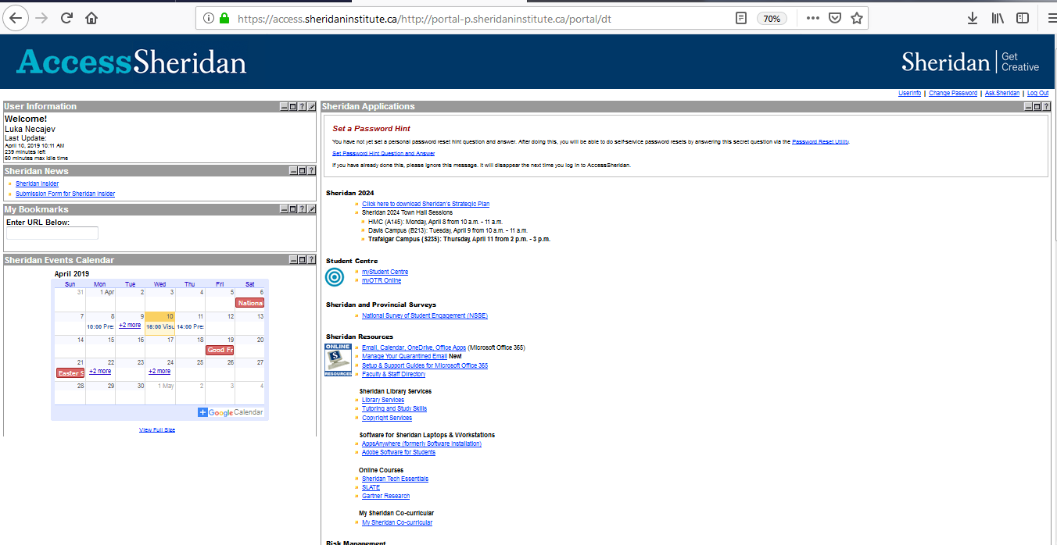
Initial Wireframes
Original Website
Things To Improve
The Outdated Design
Display Of Information
Not working Links
Calendar does not work when clicked
Navigational Links don't work
Original Design

Slide 13
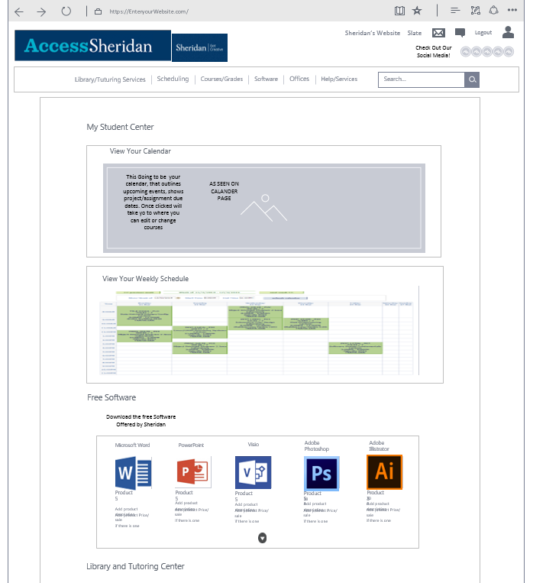
Initial Wireframes
Home Page
Things Improved
The Outdated Design
Display Of Information
View And Importance
More Functional Subpages

Slide 14
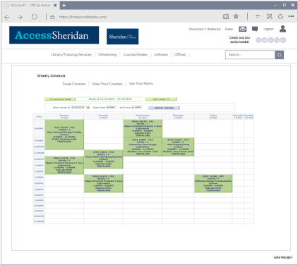
Initial Wireframes
“Weekly Schedule ” Calendar Page
Weekly Schedule
Shows you your classes day by day
Also is where your Swapping courses is located.
Almost the same as the current one except not in a separate window

Slide 15
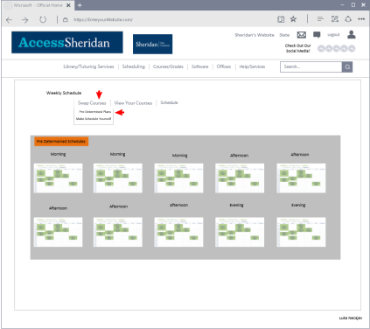
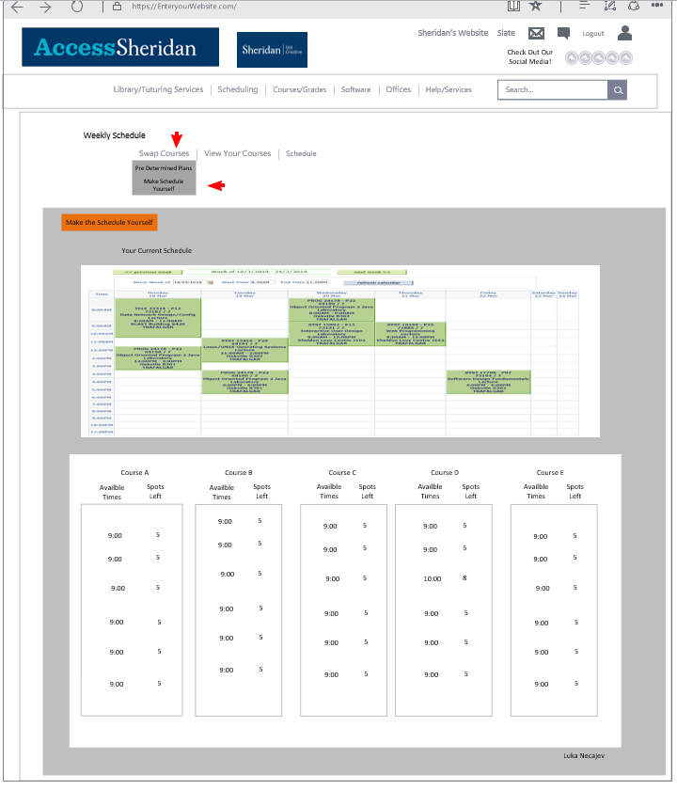
Initial Wireframes
“Swapping Courses ” Weekly Schedule Page
Predetermined Courses
Make Your Own Schedule
Swap courses
Allows you to choose courses based on teacher/rating
Also has predetermined courses, that you can choose to follow

Slide 16
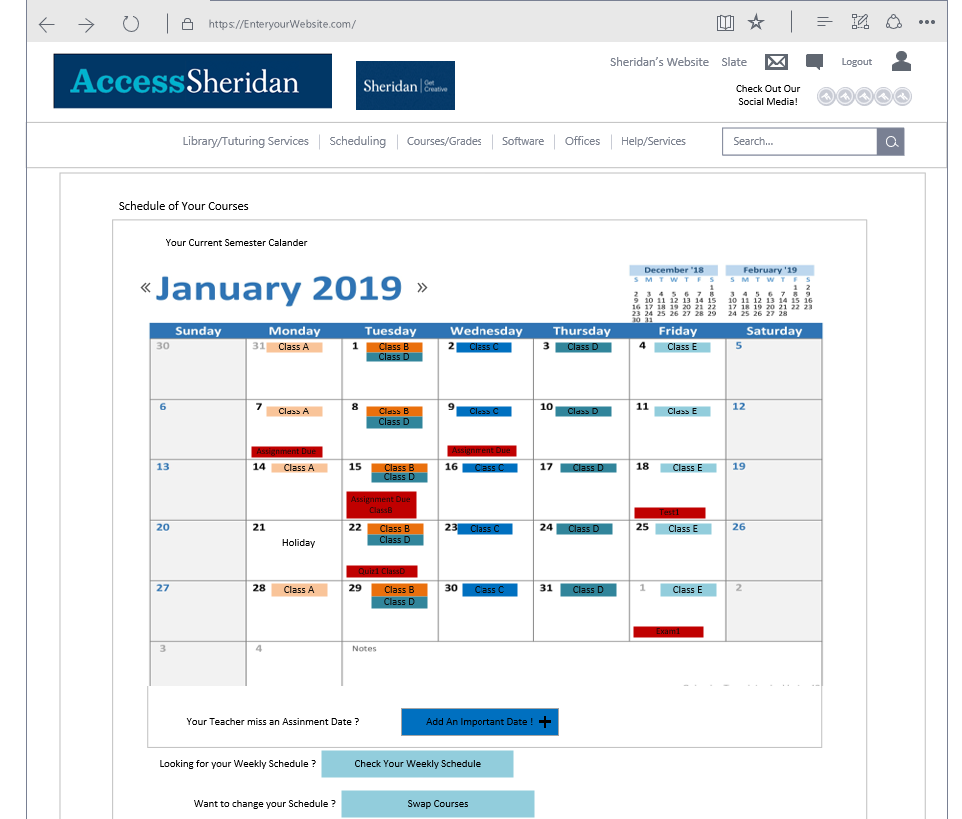
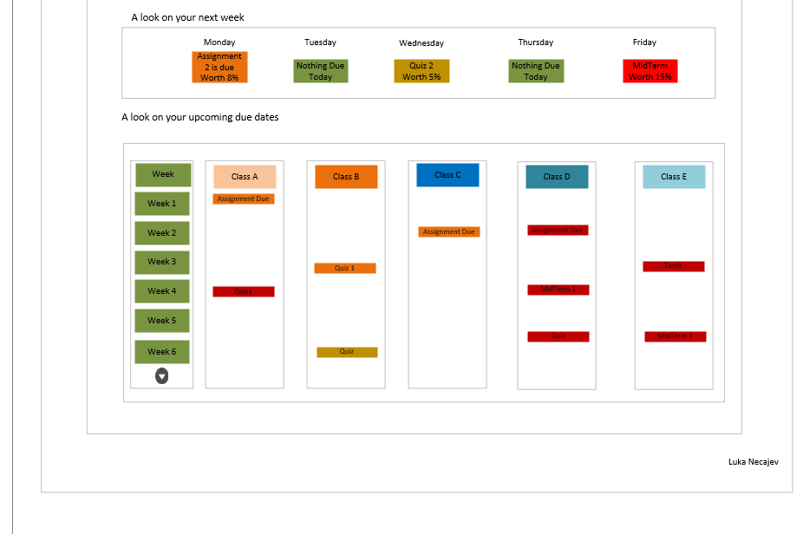
Initial Wireframes
“Calendar” Calendar Page
Calendar Page
This page is for you to view your upcoming assignments /Important dates
This page also contains your Weekly Assignments

Slide 17
REVISED WIREFRAMES
Wireframes we edited
Organized Calendar Page better
Changed Navigation for Swap Courses
Changed Label’s for Scheduling and Courses/Grades
Added a direct link to swap schedules in the courses section
Changed some details about the GPA Calculator

Slide 18
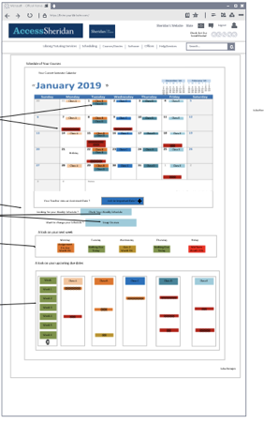
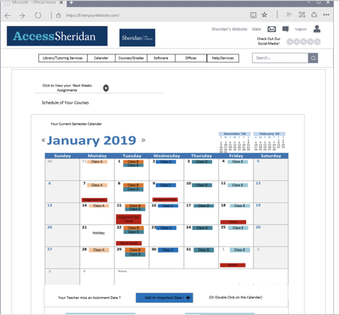
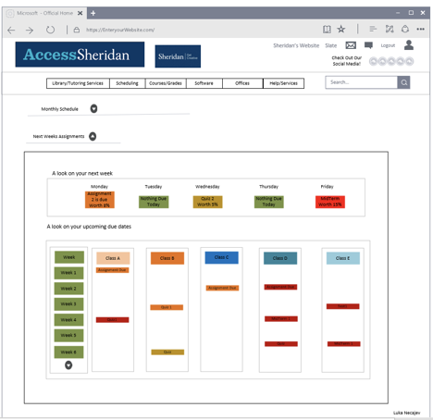
Revised Wireframes
“Calendar ” Calendar Page
Monthly schedule
The initial one was in the one page which was a little cluttered.
Revised one was separating into two pages(weekly schedule & weekly assignments) and adding dropdown menu.

Slide 19
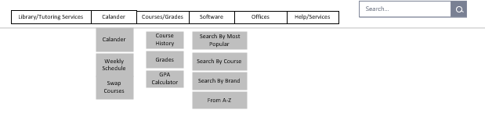
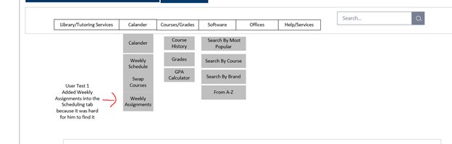
Revised Wireframes
Navigation Links
Initial Design
Navigational Links
I added the Weekly Assignments into the navigation
Changed Design

Slide 20
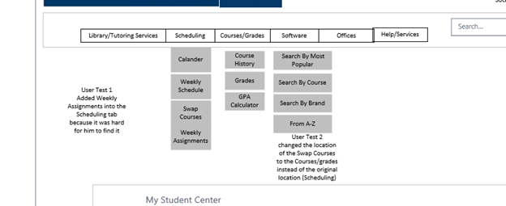
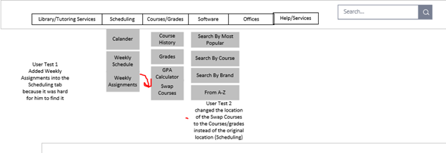
Revised Wireframes
Navigation Links Part 2
Initial Design
Navigational Links
Moved The Swap Courses Navigation into the Courses Tab
Changed Design

Slide 21
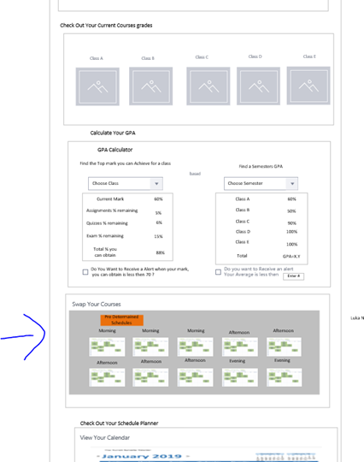
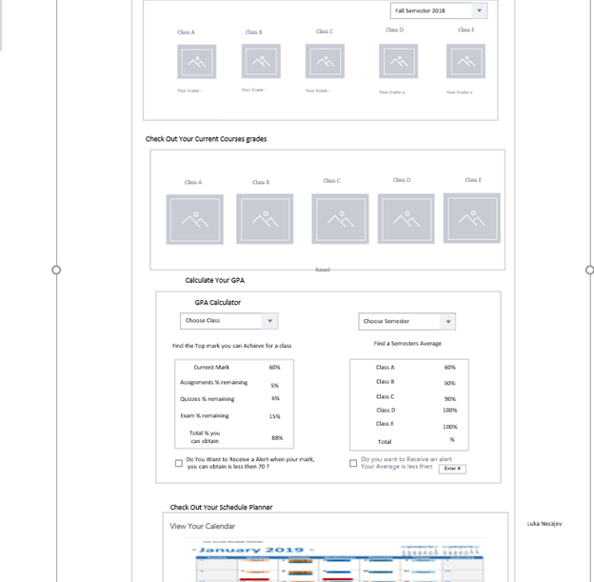
Revised Wireframes
Adding Swap Courses into Courses
Swapping Courses
Added Swapping Courses link in the Mainpage of Courses
Initial Design
Changed Design

Slide 22
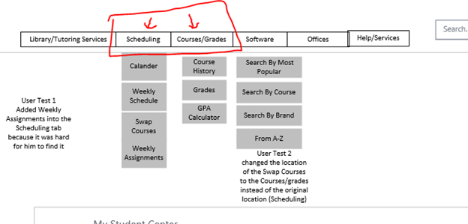
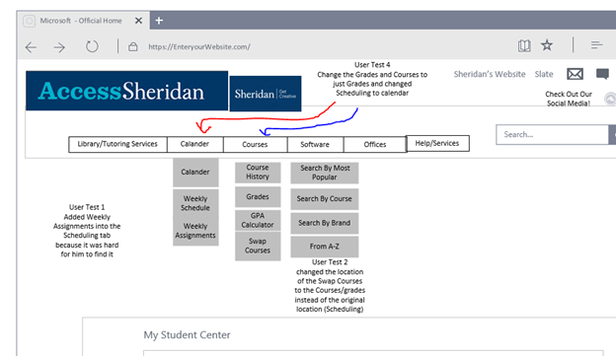
Revised Wireframes
Changed Labels
Initial Names
Label Change’s
Scheduling to Calendar
Courses/Grades to just Courses
Changed Names

Slide 23
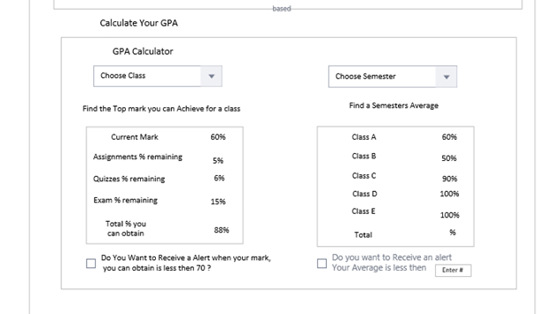
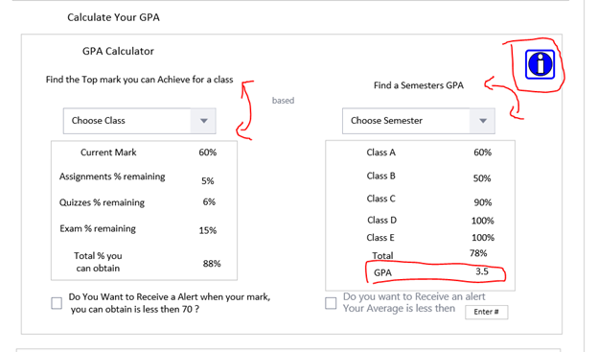
Revised Wireframes
Changing The GPA Calculator
Courses Page
Swapped the titles around
Actually added the gpa part instead of just your % mark
Added an information icon
Initial Design
Changed Design

Slide 24
What Do We Plan To Do Next ?
A true one stop hub for students; including everything a student would need on one single site.

Slide 25

Thank You For Listening
Hope you liked our design
Thanks for listening

Slide 26
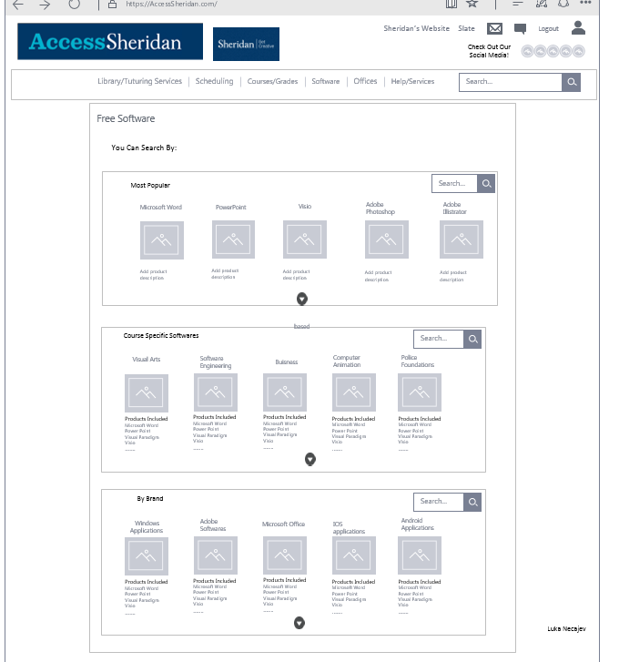
Initial Wireframes
“Home” Software Page
Things Improved
Incorporated new design
Display Of Information
View And Importance
More Functional Subpages

